Slide 1
PRESENT PROGRESSIVE

Slide 2
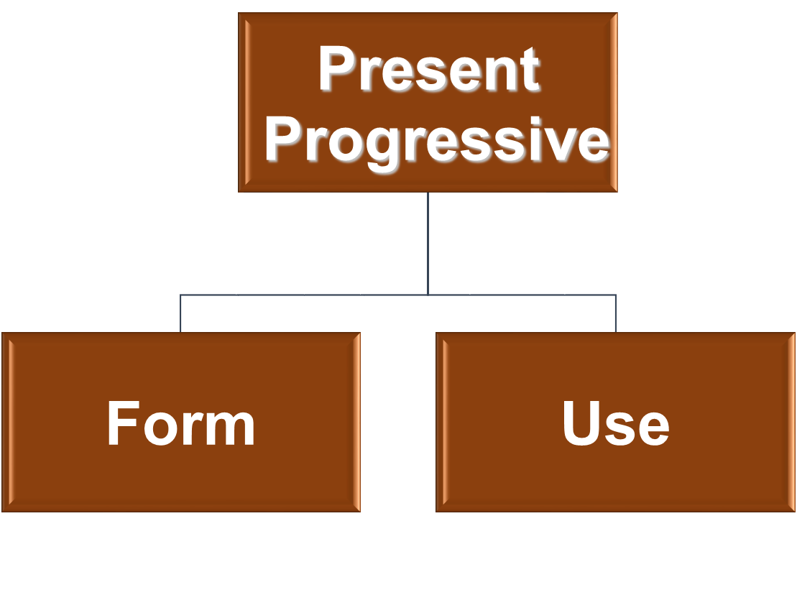

Slide 3
PRESENT PROGRESSIVE
FORM

Slide 4
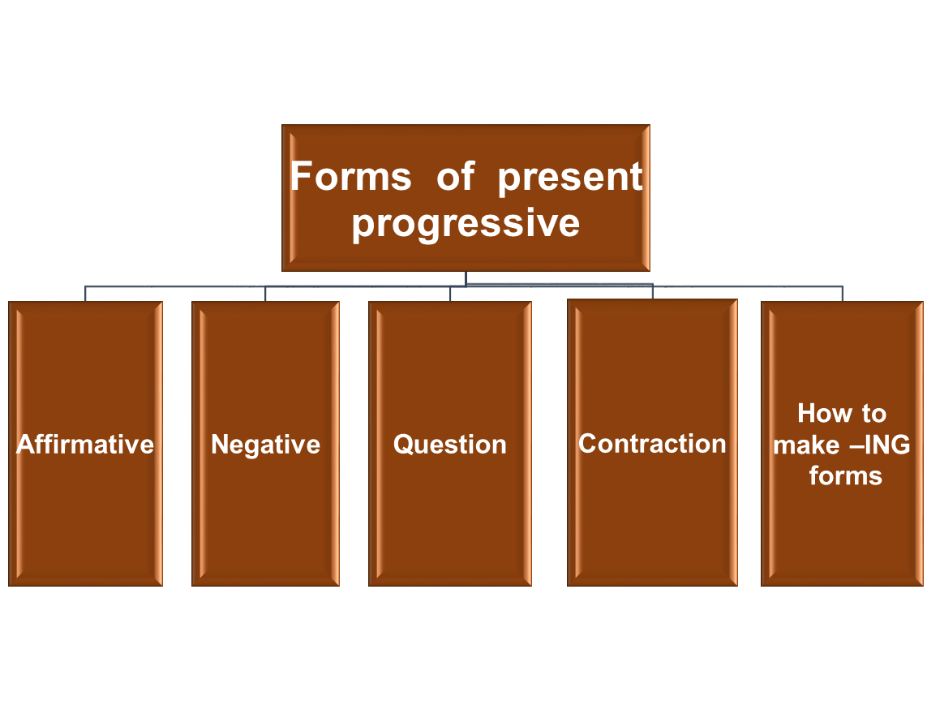

Slide 5
Affirmative
We make present progressive
verbs with be:
I am
He/she/it is
You/they/we are

Slide 6
Present progressive form
is
Subject + are + Verb (base) + ing + Complement
am
He is going to London
They are going to London
It is used to talk about something that happening now.

Slide 7
Examples:
I am working today.
You are working today.
He is working today.
She is working today.
It is working today.
We are working today.
They are working today.
The lesson is starting now.
You are talking too fast.
I am enjoying this party.
We are learning a bit of English.
The cat is eating a bird.

Slide 8
USE AM, ARE AND IS
1.My sister….a doctor.
- My sister is a doctor.
2.John and Ann …. in America.
- John and Ann are in America.
3.Our house …. very small.
- Our house is very small.
4.I …. happy today.
– I am happy today.
5.I think you…. tired.
- I think you are tired.

Slide 9
Negative
In English, in order to claim that something is not true, you form a negative sentence by adding the word not after the first auxiliary verb in the positive sentence.
I am not working today.
You are not working today.
He is not working today.
She is not working today.
It is not working today.
We are not working today.
They are not working today.

Slide 10
Negative
Examples:
Sam is not wearing his usual glasses.
Peter is not trying to save money.
Make present continuous negative sentences.
1.I ……….this party. (enjoy)
-I am not enjoying this party.
2.It ………now. (rain)
-It is not raining now.
3.You……….to me. (listen)
You are not listening to me.
4.Peter……….to school this week. (go)
-Peter is not going to school this week.

Slide 11
Questions
We make present continuous questions with:
am/are/is +subject +v-ing
Am I working today?
Are you working today?
Is he working today?
Is she working today?
Is It working today?
Are we working today/?
Are they working today?

Slide 12
Examples:
Are you talking to me?
What are you drinking?
Are we going too fast?
Is it stopping?
Is your sister enjoying the concert?
Are they eating?
Why are all those people laughing?

Slide 13
STATEMENT: It is raining.
QUESTION: Is it raining?
Q. Make present progressive questions.
1.you/ work/ tonight..
-Are you working tonight?
2.why/ those children/ cry.
Why are those children crying?
3.All your friends/ play football/ this afternoon.
-Are all your friends playing football this afternoon?

Slide 14
Negative structures: negative questions
Structure: Contracted and uncontacted negative questions
have different word order.
-auxiliary verb+ n’t + subject
Doesn’t she understand?
Why haven’t you booked your holiday yet?
Aren’t you ready?
Is not she working today?
-auxiliary verb+ subject +not
Does she not understand?
Why have you not booked your holiday yet?
Are you not ready?
Is Mrs. Allen not at home?
Is she not working today?

Slide 15
Contractions
CONTRACTION | PRONUNCIATION | MEANING
I’m |  | I am
you’re |  | you are
he’s |  | he is
she’s |  | she is
It’s |  | It is
we’re |  | we are
they’re |  | they are
there’s |  | there is
aren’t |  | are not
Isn’t |  | Is not

Slide 16
How to make –ING forms
1-Most verbs:+ ing
work: working
sleep: sleeping
2-Verbs ending in (e) + ing
make: making
hope: hoping
date: dating
injure: injuring

Slide 17
How to make –ING forms
3-ie changes to y+ ing
lie: lying
die: dying
4-Verbs that end in two consonant: just add + ing
start: starting
fold: folding
demand: demanding

Slide 18
How to make –ING forms
4-Verbs that end in (y):
a-If –y is preceded by a vowel, keep the –y
and add –ing.
enjoy: enjoying
pray: praying
buy: buying
b-If –y is precede by a consonant, keep the –y and add –ing.
study: studying
try: trying
reply: replying

Slide 19
How to make –ING forms
6-Verbs that end in a vowel and a consonant:
7-Verbs that end in two vowels and a consonant
(double consonants+-ing)
stop: stopping
rob: robbing
beg: begging
(don’t double)
rain: raining
fool: fooling
dream: dreaming

Slide 20
How to make –ING forms
8.a- 2 syllable verbs
(1st syllable stressed)
listen: listening
offer: offering
open: opening
8.b- 2 syllable verbs:
begin: beginning
prefer: preferring
control: controlling

Slide 21
How to make –ING forms
Final w (in words like show, flow) is part of a vowel sound, and is not doubled.
show: showing (Not showwing)
In British English, we double –l at the end of a word after one vowel letter, in most cases, even in unstressed syllables.
travel: travelling
In American English, words like this are most often spelt with one l :
traveling.
Other exceptions:
‘combat-combating or combatting

Slide 22
How to make –ING forms
Final –s is sometimes doubled in ‘focus(s)ing
Final –c changes to ck before -ing etc.
panic: panicking

Slide 23
Write the –ing forms of these verbs
wash
get
come
jump
shout
stand
answer
forget
washing
getting
coming
jumping
shouting
standing
answering
forgetting
sit
talk
write
open
sing
put
slim
turn
sitting
talking
writing
opening
singing
putting
slimming
turning

Slide 24
Passive
Object + is + being + Verb(p.p)
are
He is cleaning the window (present continuous)
The window is being cleaned (Passive)

Slide 25
Example
Sheila is drinking a cup of tea.
My father is washing the car.
Farmer Joe is milking the cows.
She is taking a picture of him.
I am writing a poem.
We are not playing football.
He is not wearing a tie

Slide 26
Example
Sheila is drinking a cup of tea. - A cup of tea is being drunk by Sheila.
My father is washing the car. - The car is being washed by my father.
Farmer Joe is milking the cows. - The cows are being milked by farmer Joe.
She is taking a picture of him. - A picture of him is being taken by her.
I am writing a poem. - A poem is being written by me.
We are not playing football. - Football is not being played by us.
He is not wearing a tie. - A tie is not being worn by him.

Slide 27
PRESENT PROGRESSIVE USE

Slide 28
We use the present continuous to talk about temporary actions and situations that are going on now or around now: before, during and after the moment of speaking.
-What are you doing? I’m writing letters.
-Hurry up! We’re all waiting for you!
PAST NOW FUTURE

Slide 29
You can use the present progressive with today/ this/ this year etc. (periods around now)
-The company isn’t doing so well this year.

Slide 30
Changes
We use the present progressive to talk about developments and changes happening around now, especially with these verbs:
get, change, become, increase, rise, fall, grow, improve, begin, start, go
-That child is getting bigger every day.
-House prices are going up again.
-The population of the world is increasing very fast.

Slide 31
Talking about the future
We often use the present progressive to talk about the future
-What are you doing tomorrow evening?
-Come and see us next week if you’re passing through London.

Slide 32
Common non-progressive verbs
Here is a list of some common verbs which are not used in progressive forms (or which are not in progressive forms with certain meanings).
(1)Mental State
know | believe | imagine | want
realize | Feel | doubt | need
understand | suppose | remember | desire
recognize | think | forget | mean

Slide 33
Common non-progressive verbs
Some verbs are never or hardly ever used in progressive (continuous) forms, even if the meaning is just around now
I like this music.
(Not I’m liking this music.)
Do you believe what he says?
(Not Are you believing….?)
The tank contains about 7,000 liters at the moment.
(Not The tank is containing…)

Slide 34
(2)Emotional State
Common non-progressive verbs
love | hate | mind | astonish
like | dislike | care | amaze
appreciate | fear | prefer | surprise
please | envy
(3)Possession
possess have own belong

Slide 35
Common non-progressive verbs
(4)Sense Perceptions
taste | hear | See
smell | feel
(5)Other Existing States
seem | cost | be | consist of
look | owe | exist | contain
appear | weigh | matter | Include
sound | equal | look like | resemble

Slide 36
Common non-progressive verbs
Non-progressive
See=understand
-I see what you mean.
Look like=seem like
-That looks like our train.
Feel= have an opinion
-I feel you’re making a mistake.
Can be progressive
See=meet
I’m seeing the doctor today.
Look=turn eyes towards
-What are you looking at”
Feel = ill/tired etc (can be progressive or simple)
I’m feeling ill.
OR
I feel ill.

Slide 37
Common non-progressive verbs
Think
When think means believe or have an opinion, we do not use the continuous:
I think Mary is Canadian, but I’m not sure. (think = believe)
(Not I’m thinking)
-I think you’re wrong.
What do you think about my plan? (=What is your opinion?)
When think means consider, plan, look at ideas, the continuous is possible:
I’m thinking about what happened.
Nicky is thinking of giving up her job.(=she is considering it)
-I’m thinking about the holidays.

Slide 38
Common non-progressive verbs
Compare:
1- I’m seeing the doctor at ten o’clock.
I see what you mean.
2- I’m feeling fine (OR I feel fine.)
I feel we shouldn't do it
(Not I’m feeling we Shouldn’t do it.
-feel here=have an opinion.)
3- What are you thinking about?
What do you think of the government?
(Not What are you thinking of the government?-think here=have an opinion.)

Slide 39
Using being
He is selfish and He is being selfish
He’s being=He’s behaving/ He’s acting.
Compare:
I can’t understand why he’s being so selfish. He isn’t usually like that.
(being selfish=behaving selfishly at the moment)
He never thinks about the people. He is very selfish. (Not He is being)
(=He is selfish generally, not only at the moment)

Slide 40
Present progressive
Things that happen all the time: present progressive not used.
We do not normally use the present progressive to talk about permanent situations, or about things that happen regularly, repeatedly or all the time.
Compare:
1-Look- the cat is eating your breakfast!
-What do bears eat? ~Everything.
(Not What bears eating?...)
2- Why is that girl standing on the table?
-Chetford Castle stands on a hill outside the town.
(Not…is standing…)

Slide 41
Present progressive
I always do and I’m always doing
We can use always, continually and similar words with a progressive form to mean very often.
I’m always losing my keys.
I’m continually running these days.
This structure is used to talk about things which happen very often (perhaps more than expected), and which are unexpected or unplanned.
Compare:
a. When Alice comes to see me, I always meet her at the station.
-(a regular, planned arrangement)
b. I’m always meeting Mrs. Bailiff in the supermarket.
-(accidental, unplanned meetings)

Slide 42
Q- Circle the correct answers.
1.’Your English gets / is getting better.’ ’Oh, thank you.’
-’Your English is getting better.’ ’Oh, thank you.’
2.’Where’s Susan?’ ’She comes / She’s coming now.’
’Where’s Susan?’ She’s coming now.’
3.’Do you smoke? / ‘Are you smoking?’ ‘No, never.’
-’Do you smoke? ‘No, never.’
4.John cooks dinner now / every Sunday.
- John cooks dinner every Sunday.

Slide 43
Put in the correct verb forms.
1.We………..the bank manager this afternoon. (see)
-We are seeing the bank manager this afternoon.
2.’I…………..you’re crazy.’ ’I…………….’(think; see)
-’I think you’re crazy.’ ’I see’
3.’What….……about?’ ’Life. ’(you/think)
-’What are you thinking about?’ ’Life.
4. Why……..…at me? (that woman/look)
-Why is that woman looking at me?
5.She……………...your sister. (look like)
-She looks like your sister.
6.I…….……..that she doesn’t like me. (feel)
-I feel that she doesn’t like me.

Slide 44
True or False
1.You’re driving too fast.
(T)
2.What is this word meaning?
(F)
3.I’m not wanting a drink just now.
(F)
4.Where are you living now?
(T)
5.I’m thinking you’re wrong.
(F)
6.Sorry,I’m not understanding.
(F)

